Slide 1

Coffee report
Key insights for a successful coffee hub

Slide 2
Executive Summary
Focus on sweet, chocolate-forward coffees.
Prioritise origins with high ratings and strong student appeal.
Partner with top-performing roasters.
Stock mainly medium and medium-dark roasts.
Offer premium, everyday, and seasonal coffee options.

Slide 3
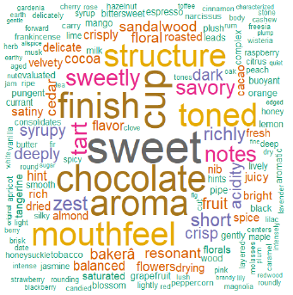
Student Preferences
Student Match Score built from flavour keywords.
Students favour sweet, chocolate, fruity and rich coffees.
Use flavour profile as a key selection criterion.

Slide 4
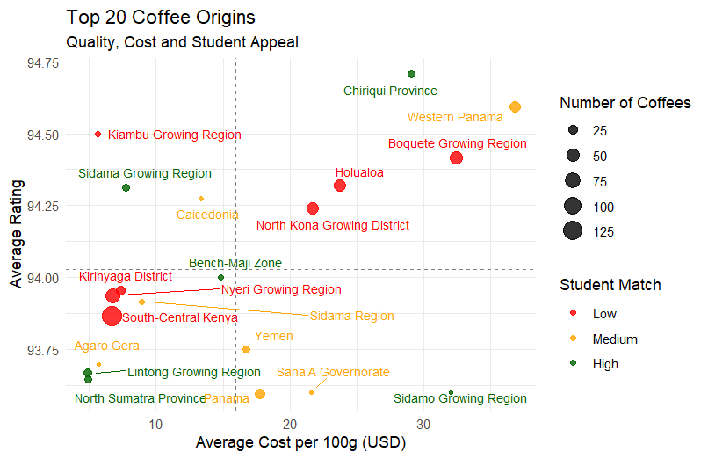
Coffee Origin Analysis
Compare quality, cost and student appeal.
Select origins with high ratings and reasonable costs.

Slide 5
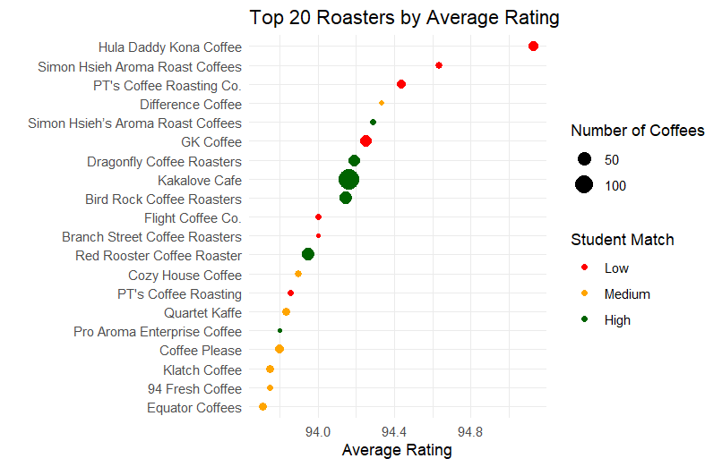
Roaster Analysis
Identify suppliers with consistently high ratings.
Prefer roasters with broad offerings and strong appeal.

Slide 6
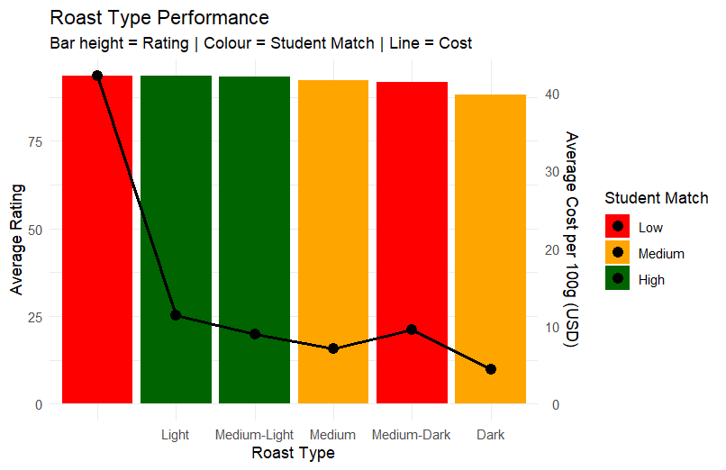
Roast Type Analysis
Compare ratings, student appeal and cost.
Medium and Medium-Dark roasts are likely strongest options.

Slide 7
Recommended Portfolio
Premium Signature Coffee.
Everyday Student Favourite.
Seasonal Rotating Coffee.

Slide 8
Final Recommendation
Balance quality, student preferences and profitability.
Source from top-rated origins and roasters.
Build a menu around sweet, chocolate-forward coffees.

